Slide 1
Collibra Workflows
Proposing a New Business Asset

Slide 2
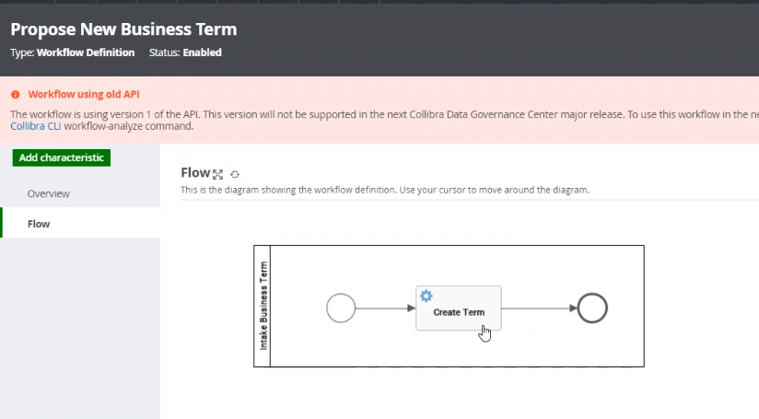
Current OOB Workflow: Propose New Business Term vs. Propose Business Asset
No approval process in either workflow
Propose business asset will show a drop down list of asset types.

Slide 3
MHF: Propose New Business Asset with Approval
High Level
Business Assets to Include:
Business Term
Acronym
Measures
Metrics
KPI’s
Report Dimensions
Consumer
DGA
BS
Stakeholder
DGA
Consumer submits a new asset (Candidate Status)
DGA will review, add LOB and sends to BS & Stakeholder (if assigned) to vote (same time) (Under review Status). Need the ability to communicate back and forth between the any of the listed roles. (only one level back allowed). Need a comment section.
BS votes Approve, Reject, Approve with Edit.
Stakeholder votes, Approve, Reject, Approve with Edit. If no voting occurs within … time frame default to approve.
If: BS or Stakeholder Reject needs to go back to DGA. Rejection reason must be stated in a free text box.
If Approved: The asset status will change to Accepted.
5. DGA will author the asset into Collibra, status will move to Approved.
6. Communicate outcome of submission to submitting consumer no matter where in the flow it was rejected and only the final approval.
Roles to Include:
Data Governance Analyst
Consumer
Business Steward
Stakeholder (the BS of the secondary LOB)
Do we need to have BS and stakeholders M/M/KPI’s or just DGA and Analytic Leadership?
Need to figure out what to do with terms owned by DSC.

